Slide 1
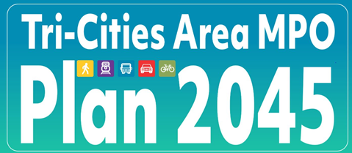
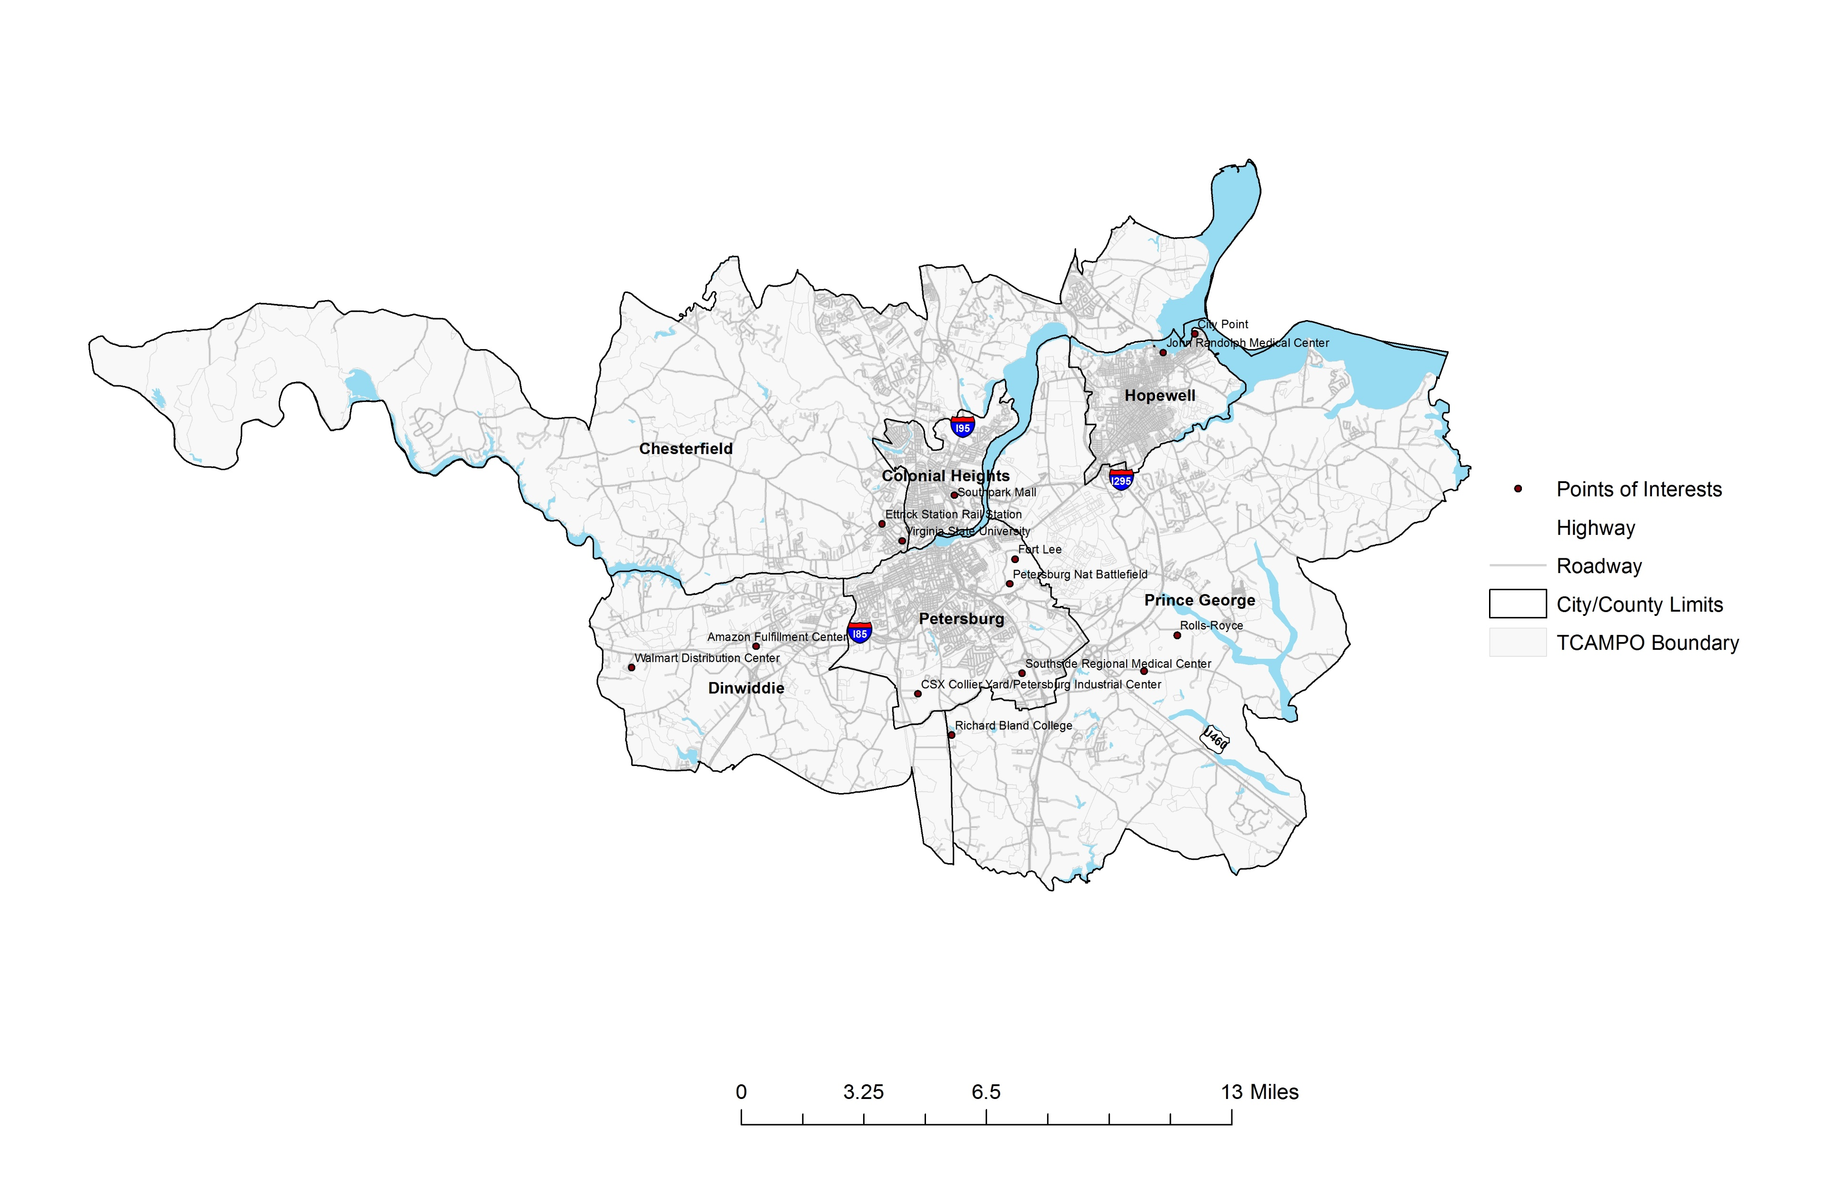
Plan 2045 | Crater Planning District Commission (craterpdc.org)

Slide 2
What is the Tri-Cities Area MPO?
The Tri-Cities Area MPO was created in 1974 under a cooperative agreement between the Crater Planning District Commission and the Virginia Department of Highways.

Slide 3
What is the Tri-Cities Area MPO?
In 1979, the Secretary of Transportation designated the Tri-Cities Area Policy Committee as the Metropolitan Planning Organization (MPO) for the Tri-Cities Area.

Slide 4
What is the Tri-Cities Area MPO?
The Tri-Cities Area MPO serves as the Transportation Planning Forum overseeing federally funded transportation projects and plans in the Tri-Cities Area.

Slide 5
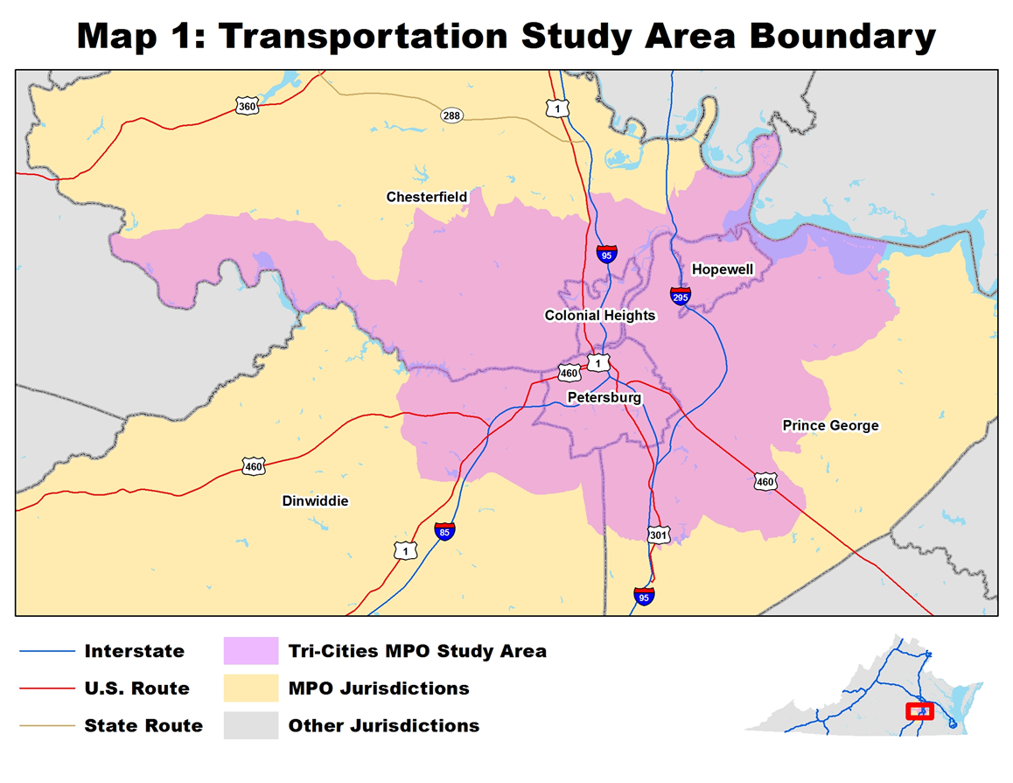
What is the Tri-Cities Area MPO?
MPO Members:
City of Colonial Heights
City of Hopewell
City of Petersburg
Chesterfield County
Dinwiddie County
Prince George County
Petersburg Area Transit
Secretary of Transportation
Crater Planning District Commission

Slide 6
What is the Tri-Cities Area MPO?
Other Key Tasks by the MPO:
The MPO selects and/or recommends transportation projects for federal STBG ($3.5M/yr.), CMAQ ($1.4M/yr.), and TAP funding ($230k/yr.) allocated to the Tri-Cities Area MPO
The MPO also applies for projects under various federal and state programs such as SMART SCALE, RAISE, and federal annual appropriation requests

Slide 7

What is Plan2045?
Plan2045 is the Tri-Cities Area MPO’s long-range transportation plan (LRTP) that represents the vision and goals for transportation improvements in the region’s transportation system.

Slide 8
What is Plan2045?
The intent of Plan2045 is to meet future-oriented, multi-modal transportation needs of the region, such as autos, transit, bicycling, pedestrians, and freight.

Slide 9
What is Plan2045?
The MPO LRTPs are updated on a 5-year cycle. The current plan (2040 LRTP) was adopted in August 2017 and is consistent with federal laws and regulations.
Plan2045 is the update to the LRTP, website:
Plan 2045 | Crater Planning District Commission (craterpdc.org)

Slide 10
What is Plan2045?
Plan2045 is data-driven, needs and performance-based, and has greatly expanded public involvement.

Slide 11
What was Used to Create Plan2045?
Major Public Participation Outreaches
Vision, Goals, and Objectives Survey (January 2021)
Needs, Problems, and Issues Survey (July-August 2021)
Plan2045 website
Promoting the Surveys and Plan2045 website on Facebook, Instagram, and locality distribution lists

Slide 12
What was Used to Create Plan2045?
Sources for Plan2045:
VTrans and VDOT Data and Needs Identification
TCAMPO’s Congestion Management Process (CMP)
Corridor Studies/Plans (I-95, Route 36)
Bicycle/Pedestrian/Trail Plans
Transit Development Plans (TDPs)
Travel Demand Models
Other plans and studies performed by VDOT and DRPT

Slide 13

What is Our Vision for Plan2045?
“Encourage a transportation system that equitably improves safety, economic vitality, and quality of life for people living and working in the Tri-Cities area.”

Slide 14
What Are Our Goals for Plan2045?
Safety
Mobility/Congestion
Accessibility/Equity/Multimodal
Environmental Quality
Economic Development
These goals are used as factors for prioritizing our Plan2045 projects, etc.

Slide 15

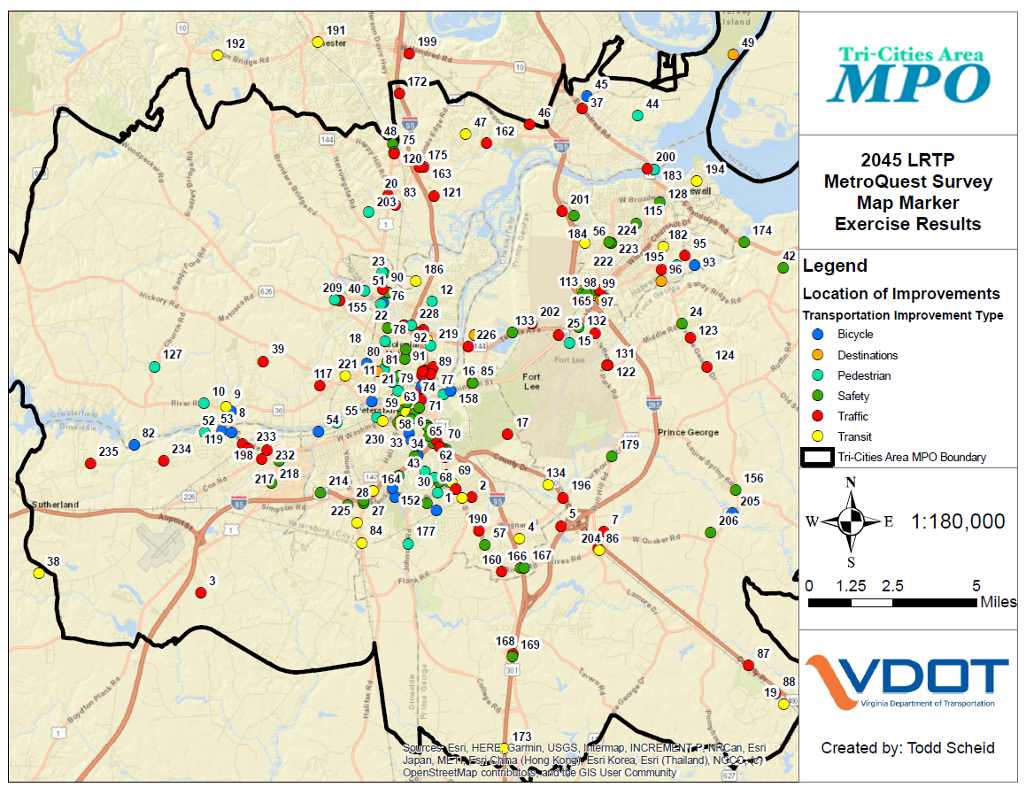
Where Did You See our Problems and Needs?

Slide 16
How Are We Doing? Safety

Slide 17
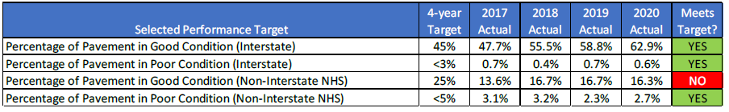
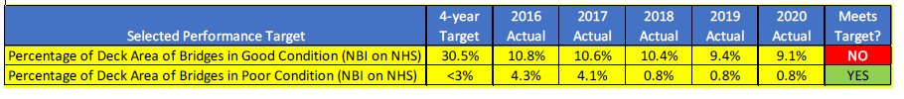
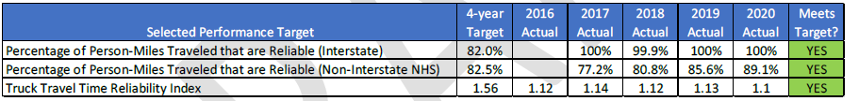
How Are We Doing? Pavement, Bridges, System Reliability

Slide 18
What Funding Is Expected to be Available Through 2045?
$296 Million for Highway Capital
$1,116 million for Highway Maintenance
$45 million for Administrative
$140 million for CVTA projects
$22 million for Transit Operating
$6 million for Transit Capital

Slide 19
What Major Projects Are Proposed?
Route 144 (Temple Ave) from Conduit Ave. to Colonial Hts. East City Line (0.93 miles)
Route 620 (Wood Edge Rd.) from Route 1 to east of the railroad (0.40 miles)
Route 746 (N. Enon Church Rd.) from Meadowville Technology Parkway to Route 10 (0.80 miles)
Cedar Level Road Southern Section (0.50 miles)
East-West Freeway (west of Branders Bridge Rd to Route 1)

Slide 20

What is Also Required for Plan2045?
Air Quality Conformity Report
Required under a 2018 federal court order when an MTIP and/or MTP are updated in our MPO Study Area
Includes projects individually listed in the FFY 2021-24 MTIP and Draft Plan2045 and identifies if they are regionally significant for air quality
Air Quality models were used in 2018 and a proposed finding of conformity was assumed in the draft conformity report.
Approved by the MPO April 14, 2022. Awaiting federal approval.

Slide 21
Plan2045 Website: Plan 2045 | Crater Planning District Commission (craterpdc.org) Call Ron Svejkovsky at 804-861-1666 Email Ron Svejkovsky at rsvejkovsky@craterpdc.org
Where Can I Find Plan2045 and Comment on it?

Slide 22
Thank you!

